Slide 1
Project:
Insurance Policy Endorsement
Group Number: 4
Mentor: Mrs. Shital Patil
Notes:
Add instructor notes here.

Slide 2
Objectives
Project Understanding
Approach used
Project Execution
Modules
Learning
Best Practices
Opportunity for improvement
Demo and Code Walkthrough
Q&A
Notes:
Add instructor notes here.

Slide 3
Project Understanding
In property/casualty insurance the term endorsement means
a document attached to an insurance contract that amends
the policy in some way.
An endorsement may add, remove or alter the scope of
coverage under the policy.
The insurance endorsement is a legally binding amendment to
the insurance contract.
Technologies Used:
ASP.NET 4.5 with MVC 5
Notes:
Add instructor notes here.

Slide 4
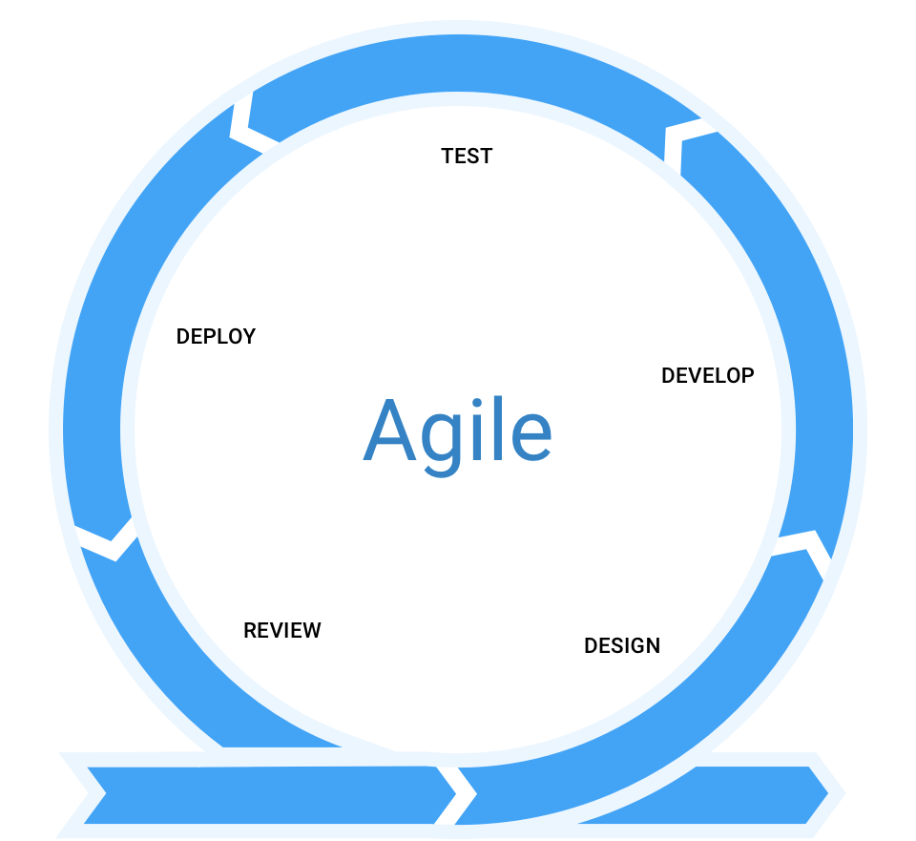
Approach used : Agile Model
The agile software development emphasizes on four core values:
Individual and team interactions over processes and tools.
Working software over comprehensive documentation.
Customer collaboration over contract negotiation.
Responding to change over following a plan.
Notes:
Add the notes here.
Add instructor notes here.

Slide 5
Modules
Following are the modules that we have implemented in this project:
Customer:
A customer can perform following actions using this application:
Login
Search Policy
View Policy Details
Update Policy Details
Check Endorsement Status
Notes:
Add the notes here.
Add instructor notes here.

Slide 6
Modules
Login: Customer can login to this application using his/her credentials.
Search Policy: Customer can search for a specific policy using the policy number.
View Policy Details: After search, customer can view the details of that policy on a separate page.
Update Policy Details: In view policy page, customer can update the policy details (if required) and click on update in order to update policy details.
Check Endorsement Status: Post updating the policy details, customer can check whether the request is approved by admin or not, using this functionality.

Slide 7
Modules
Admin:
An admin can perform following functions:
Admin Login
Status Approval / Rejection
Admin Login: Admin can login to this application using his/her credentials.
Status Approval / Rejection: When a customer requests for changes in policy details, he/she uploads supporting documents for requested changes. The admin verifies the uploaded documents and decides the approval / rejection of the request.

Slide 8
Learning
While doing this project, we have learnt ASP.Net 4.5 and MVC 5 architecture and developed a web application.
Proper documentation of the project.
How to perform testing on a particular unit of a project.
Following proper coding standards.
Exception handling and debugging.
Working in a team.
Data Transfer from View to Controller and vice versa.
Division of work for individual team member.
Notes:
Add the notes here.
Add instructor notes here.

Slide 9
Best Practices
Write Comments And Documentation
Naming Convention Should Be Proper
Code Review
Readable And Efficient Code
Avoid Hard Coding Values
Write Test Cases
Backup And Save Your Work Often
Notes:
Add the notes here.
Add instructor notes here.

Slide 10
Opportunity for improvement
It will be safe to presume that online is the future for the
Indian insurance industry.
Digitalization will make people more knowledgeable about
various types of insurance policies.
Here you can search for a particular type of insurance and can
compare between many brands to get the best deal.
Also, you get an appropriate amount of time to do proper
research before buying the policy.
In future, new users can register themselves and purchase
new policies using this application.
Notes:
Add the notes here.
Add instructor notes here.

Slide 11
Thank You

Slide 12
Q & A
Notes:
Add the notes here.
Add instructor notes here.

